Slide 1
Children types. Array as children, Function as children
By Yurii Martynenko

Slide 2
Agenda
Specifying The React Element Type
Children in JSX
JSX Children
JavaScript Expressions as Children
Array as children
Functions as Children
Booleans, Null, and Undefined

Slide 3
Specifying The React Element Type

Slide 4
Specifying The React Element Type
The first part of a JSX tag determines the type of the React element.
Capitalized types indicate that the JSX tag is referring to a React component.
These tags get compiled into a direct reference to the named variable, so if you use the JSX <Foo />expression, Foo must be in scope.

Slide 5
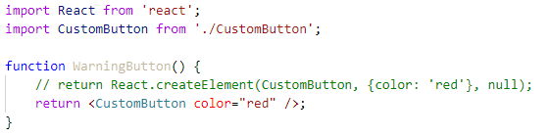
React Must Be in Scope
Since JSX compiles into calls to React.createElement, the React library must also always be in scope from your JSX code.
For example, both of the imports are necessary in this code, even though React and CustomButton are not directly referenced from JavaScript:
If you don’t use a JavaScript bundler and loaded React from a <script> tag, it is already in scope as the React global.

Slide 6
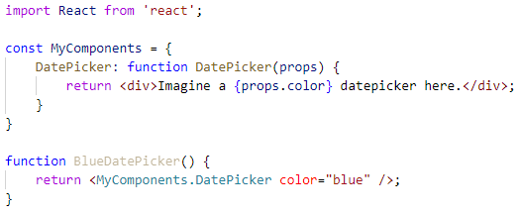
Using Dot Notation for JSX Type
You can also refer to a React component using dot-notation from within JSX. This is convenient if you have a single module that exports many React components. For example, if MyComponents.DatePicker is a component, you can use it directly from JSX with:

Slide 7
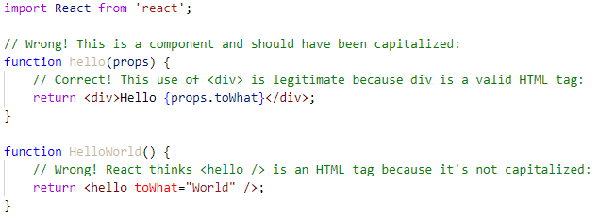
User-Defined Components Must Be Capitalized
When an element type starts with a lowercase letter, it refers to a built-in component like <div> or <span> and results in a string 'div' or 'span' passed to React.createElement. Types that start with a capital letter like <Foo /> compile to React.createElement(Foo) and correspond to a component defined or imported in your JavaScript file.
We recommend naming components with a capital letter. If you do have a component that starts with a lowercase letter, assign it to a capitalized variable before using it in JSX.
For example, this code will not run as expected:

Slide 8
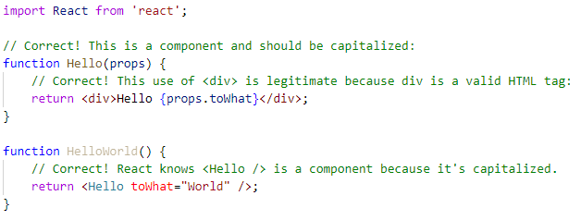
To fix this, we will rename hello to Hello and use <Hello /> when referring to it:

Slide 9
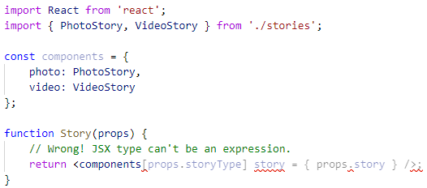
Choosing the Type at Runtime
You cannot use a general expression as the React element type. If you do want to use a general expression to indicate the type of the element, just assign it to a capitalized variable first. This often comes up when you want to render a different component based on a prop:

Slide 10
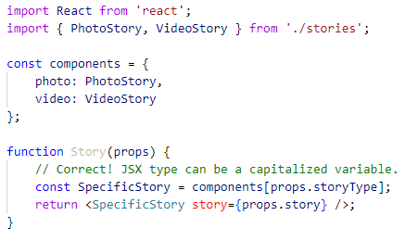
To fix this, we will assign the type to a capitalized variable first:

Slide 11
Children in JSX

Slide 12
Children in JSX
In JSX expressions that contain both an opening tag and a closing tag, the content between those tags is passed as a special prop: props.children. There are several different ways to pass children

Slide 13
String Literals
You can put a string between the opening and closing tags and props.children will just be that string. This is useful for many of the built-in HTML elements. For example:
This is valid JSX, and props.children in MyComponent will simply be the string "Hello world!". HTML is unescaped, so you can generally write JSX just like you would write HTML in this way:

Slide 14
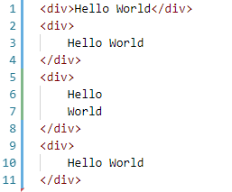
String Literals
JSX removes whitespace at the beginning and ending of a line. It also removes blank lines. New lines adjacent to tags are removed; new lines that occur in the middle of string literals are condensed into a single space. So these all render to the same thing:

Slide 15
JSX Children

Slide 16

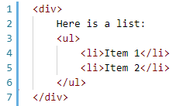
JSX Children
You can provide more JSX elements as the children. This is useful for displaying nested components:
You can mix together different types of children, so you can use string literals together with JSX children. This is another way in which JSX is like HTML, so that this is both valid JSX and valid HTML:

Slide 17
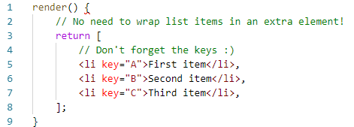
JSX Children
A React component can also return an array of elements:

Slide 18
JavaScript Expressions as Children

Slide 19

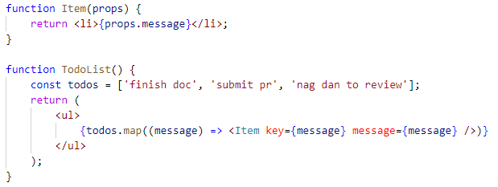
JavaScript Expressions as Children
You can pass any JavaScript expression as children, by enclosing it within {}. For example, these expressions are equivalent:
This is often useful for rendering a list of JSX expressions of arbitrary length. For example, this renders an HTML list:

Slide 20

JavaScript Expressions as Children
JavaScript expressions can be mixed with other types of children. This is often useful in lieu of string templates:

Slide 21
Array as children

Slide 22
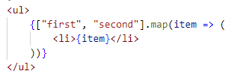
Array as children
Providing an array as children is a very common. It's how lists are drawn in React.
We use map() to create an array of React Elements for every value in the array.
That's equivalent to providing a literal array.

Slide 23

Array as children
This pattern can be combined with destructuring, JSX Spread Attributes, and other components, for some serious terseness.

Slide 24
Functions as Children

Slide 25
Functions as Children
Normally, JavaScript expressions inserted in JSX will evaluate to a string, a React element, or a list of those things. However, props.children works just like any other prop in that it can pass any sort of data, not just the sorts that React knows how to render.

Slide 26
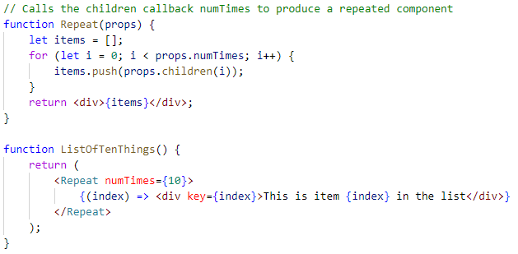
Functions as Children
For example, if you have a custom component, you could have it take a callback as props.children:
Children passed to a custom component can be anything, as long as that component transforms them into something React can understand before rendering. This usage is not common, but it works if you want to stretch what JSX is capable of.

Slide 27
Booleans, Null, and Undefined

Slide 28
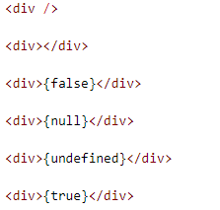
Booleans, Null, and Undefined Are Ignored
false, null, undefined, and true are valid children. They simply don’t render. These JSX expressions will all render to the same thing:

Slide 29


Booleans, Null, and Undefined Are Ignored
This can be useful to conditionally render React elements.
This JSX only renders a <Header />if showHeader is true:
One caveat is that some “falsy” values, such as the 0 number, are still rendered by React. For example, this code will not behave as you might expect because 0 will be printed when props.messages is an empty array:

Slide 30
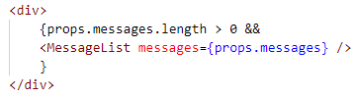

Booleans, Null, and Undefined Are Ignored
To fix this, make sure that the expression before && is always boolean:
Conversely, if you want a value like false, true, null, or undefined to appear in the output, you have to convert it to a string first:

Slide 31
USEFUL LINKS
https://reactjs.org/docs/jsx-in-depth.html#children-in-jsx
https://codedaily.io/tutorials/6/Using-Functions-as-Children-and-Render-Props-in-React-Components
https://medium.com/merrickchristensen/function-as-child-components-5f3920a9ace9
https://mxstbr.blog/2017/02/react-children-deepdive/
https://reactpatterns.com/

Slide 32
THANK YOU!

